Slide 1

SELF CONTROLLED LOCOMOTIVE
Presented by:
Manisha Rani (10600102010)
Ariba Siddiqui (10600102004)
Ruchi Darmwal (10600102015)
Vivek Singh (10600102019)
Guided By:
Mr. Anoop Raghuvanshi

Slide 2
CONTENTS
INTRODUCTION
GENERAL DESCRIPTION
NEED OF THIS PROJECT
DEMONSTRATION MODEL
TRANSMITTER SECTION
RECEIVER SECTION
MAJOR COMPONENTS
RF MODULES
WORKING OF COMPONENTS
ADVANTAGES
FUTURE SCOPE
CONCLUSION

Slide 3

INTRODUCTION
Our project automatically check the status of lights and perform the desired operation.
This idea makes our train works automatically even in the absence of driver.
.

Slide 4
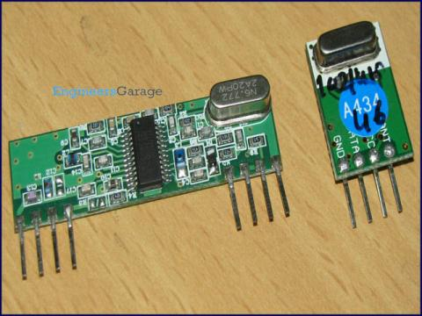
GENERAL DESCRIPTION
we have to attach a transmitter with signal pole which will start transmitting signals.
The engine has a receiver which catches these transmitted signals and takes desire actions.
Both the transmitter and receiver are of RF type with minimum range of 2 Km.

Slide 5
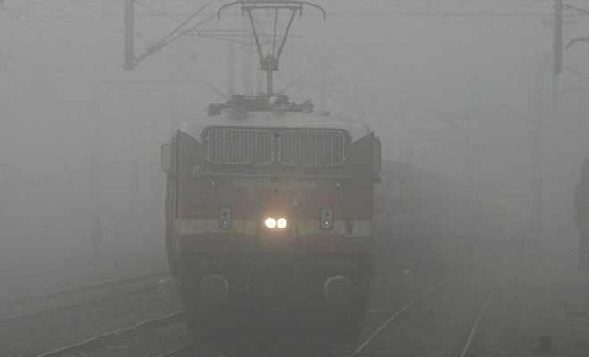
NEED OF THIS PROJECT
Fog in winter.
Misunderstanding by driver of trains.
Suddenly changing in traffic lights.
Some technical problems.
Controlling system.
Timing of signals.

Slide 6
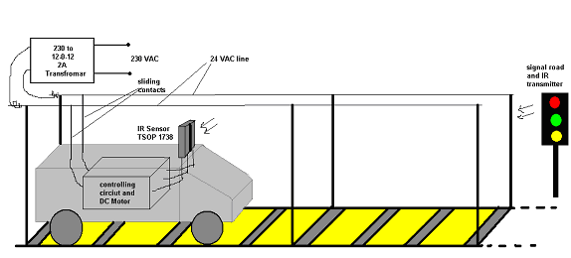
DEMONSTRATION MODEL

Slide 7
CONTINUED…
The Project is divided into two parts:
1: TRANSMITTER
The transmitter is housed in signal pole and it is activated only when power is ON.
2: RECEIVER
The receiver is housed in engine which senses the RF Signal and takes suitable action..

Slide 8
TRANSMITTER SECTION
Lights
Red, Green, Yellow
Encoder Circuit
RF Transmitter

Slide 9
RECEIVER SECTION
RF Receiver
Decoder Circuit
MC 89C51
Engine
Driving
Circuit

Slide 10
MAJOR COMPONENTS
MC 89C51
LED
RF TRANSMITTER
RF RECEIVER
ENCODER
DECODER

Slide 11
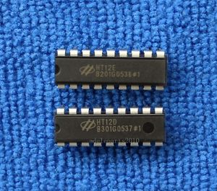
WORKING OF COMPONENTS
RF Module(434Mhz) are used for detecting the light status from poles.
A Microcontroller is used for controlling the speed of engine.
An LED for indicating pole signals.
Encoder HT12E used for encode the signal.
Decoder HT12D used for decoding.

Slide 12
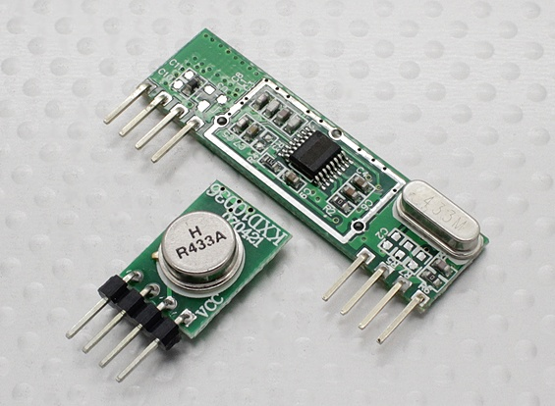
RF MODULES
The transmitter/receiver (Tx/Rx) pair operates at a frequency of 434 MHz's.
An RF transmitter receives serial data and transmits it wirelessly through RF through its antenna connected at pin4.
The transmission occurs at the rate of 1Kbps - 10Kbps.
The transmitted data is received by an RF receiver operating at the same frequency as that of the transmitter.

Slide 13

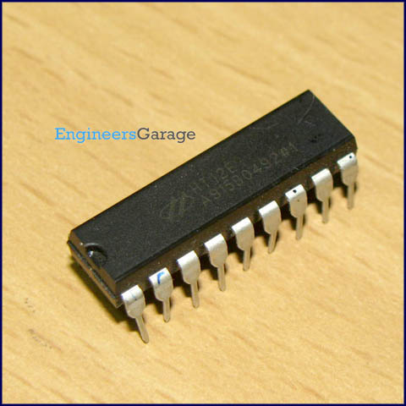
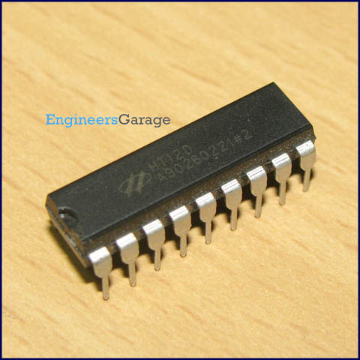
HT12E ENCODER AND HT12D DECODER
HT12E is an encoder integrated circuit of 2^12 series of encoders.
HT12E converts the parallel inputs into serial output.
HT12D is a decoder integrated circuit that belongs to 2^12 series of decoders.
HT12D converts the serial input into parallel outputs.

Slide 14
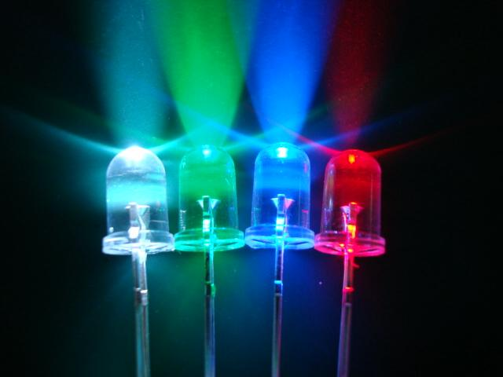
USE OF LED
Here Three LED,s Are used which are red, green And Yellow And Perform Such Operations:
IF GREEN LED GLOW- SPEED REMAINS SAME.
IF YELLOW LED GLOW-TRAIN WILL RUN AT 50% DUTY CYCLE.
IF RED LED GLOW-TRAIN WILL STOP RUNNING.

Slide 15
ADVANTAGES
The circuit is simple and cost is less.
As it is microcontroller based the speed is automatically controlled.
The circuit can be easily modified.
Prevent accident
Fault analysis is easy.

Slide 16
CONTIUED…
Quick response time
Fully Automatic system.
Robust system.
low power requirement.
Less time delays.
Can be used for other vehicles.

Slide 17
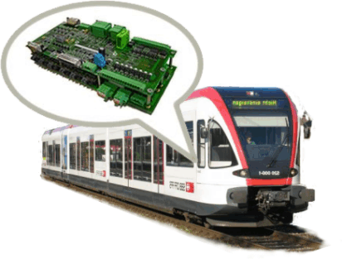
CONCLUSION
So now before the driver observes the red signal the engine itself observes it and automatically starts decreasing speed and then stops.
The driver can feel relax in driving because he doesn’t have to take care about red signal. Even if he forgets to take any action on red signal then also we can avoid accidents by the implementation of this idea.

Slide 18


Slide 19


